Slide 1
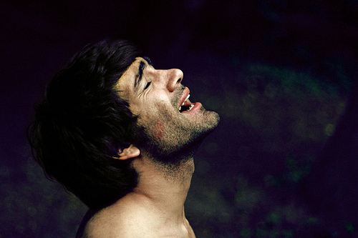
Living the Moral Life Well (And Helping Others Along the Way)
Session 29
Dr. Lewis Winkler • East Asia School of Theology (Singapore) Uploaded by Dr. Rick Griffith • Jordan Evangelical Theological Seminary Files in many languages for free download at BibleStudyDownloads.org

Slide 2
I. Introduction:

Slide 3
II. Living the Moral Life
Personally
The Role of God’s Word and the Holy Spirit (Hebrews 4:12)

Slide 4
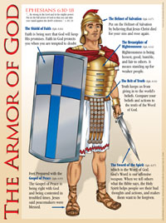
II. Living the Moral Life
Personally
The Role of God’s Word and the Holy Spirit (Hebrews 4:12)
The Role of Spiritual Battle and Armor (Ephesians 6:10-20)

Slide 5
II. Living the Moral Life
Personally
The Role of Repentance and Confession
With God (1 John 1:9)

Slide 6
II. Living the Moral Life
Personally
The Role of Repentance and Confession
With God (1 John 1:9)
With Others (James 5:16)

Slide 7
II. Living the Moral Life
Personally
The Role of Repentance and Confession
With God (1 John 1:9)
With Others (James 5:16)
The Role of Accountability (Ecclesiastes 4:9-12)

Slide 8
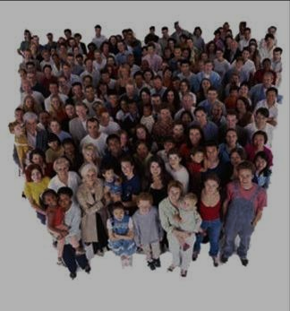
II. Living the Moral Life
Communally (Hebrews 10:24-25):

Slide 9
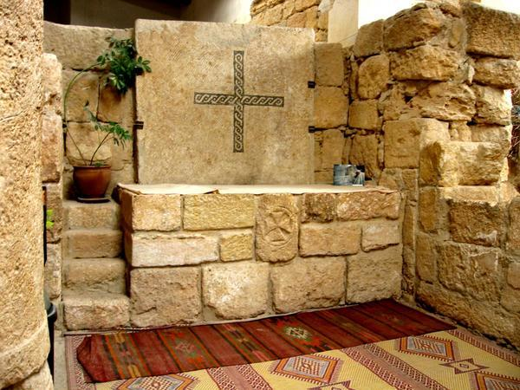
III. Helping Others along the Way
Within the Church (Matthew 18:15-18)

Slide 10
III. Helping Others along the Way
Within the Church (Matthew 18:15-18)
Within the World
Prayer and Evangelism

Slide 11
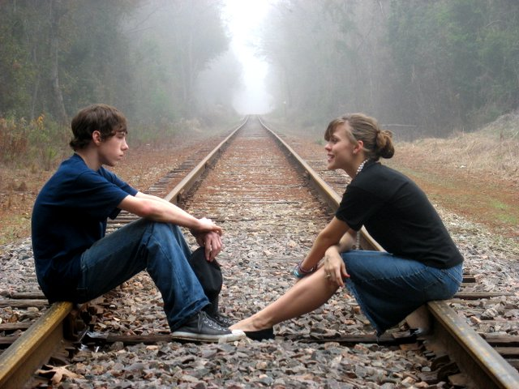
III. Helping Others along the Way
Within the Church (Matthew 18:15-18)
Within the World
Prayer and Evangelism
Moral Discourse

Slide 12
III. Helping Others along the Way
Within the Church (Matthew 18:15-18)
Within the World
Prayer and Evangelism
Moral Discourse
Moral Literature, Movies and Music

Slide 13
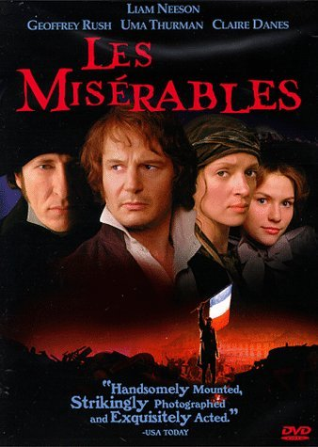
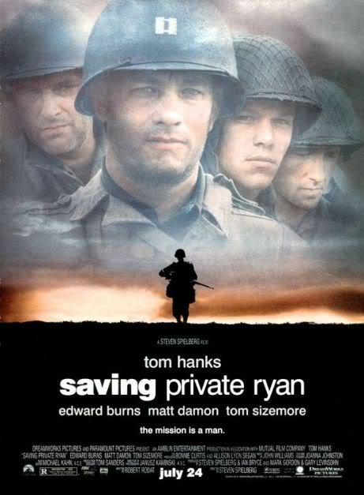
III. Helping Others along the Way
Within the Church (Matthew 18:15-18)
Within the World
Prayer and Evangelism
Moral Discourse
Moral Literature, Movies and Music

Slide 14
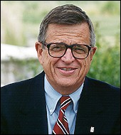
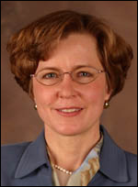
In the past, one might have challenged a moral point through reasoned argument, appealing to commonly accepted standards of right and wrong. But today, as I have discovered lecturing on campuses, young people have never been exposed to moral philosophy, but are indoctrinated instead into a perspective that treats morality as one of many strategies for self-development.
The upshot is that rational arguments no longer work. . . . Bill Bennet suggested that people today are all but impervious to moral philosophy and are more likely to be moved by moral literature. . . . Stories change us because they reach the whole person, not just the cognitive faculty. As we read, we identify with characters who demonstrate courage and self-sacrifice . . . and in the process, our own character is shaped.
Charles Colson and Nancy Pearcey in their essay on page 104 in the March 1, 1999 edition of Christianity Today, entitled, “Moral Education after Monica.”

Slide 15
III. Helping Others along the Way
Within the World
Moral Situations

Slide 16
III. Helping Others along the Way
Within the World
Moral Situations
Legislation

Slide 17
III. Helping Others along the Way
Within the World
Moral Situations
Legislation
In a Spirit of Firm and Gentle Love (1 Corinthians 13:1-3; 1 Peter 3:15)

Slide 18
IV. Conclusion:
You are the light of the world. A city set on a hill cannot be hidden. Nor do people light a lamp and put it under a basket, but on a stand, and it gives light to all in the house. In the same way, let your light shine before others, so that they may see your good works and give glory to your Father who is in heaven.
Matthew 5:14-16

Slide 19
Black

Slide 20
Worldview link at BibleStudyDownloads.org
Get this presentation for free!
Notes:
WV (Worldviews)

